Slide 1


C22-PC417
Automatic Service District Application
C22-PC417
Economic & Social Resilience (including agricultural & food security and sustainability, infrastructure, & regional development)

Slide 2
Team Member
Irena Kusuma Dewi
ML - M2313G2715
Muhammad Salman Ikrar M.
ML - M2006F0591
Gadis Mustika
CC - C7307F2631

Slide 3
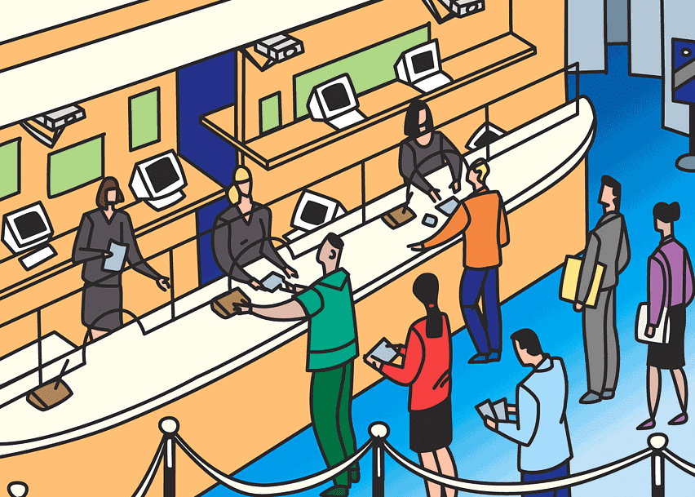
Background
complicated requirement
Long Processing
Long Queues
Notes:
Jelasin

Slide 4

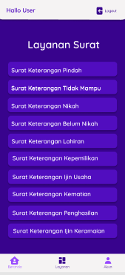
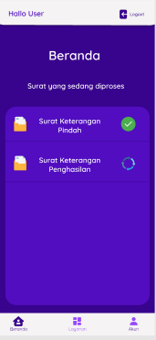
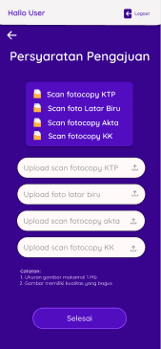
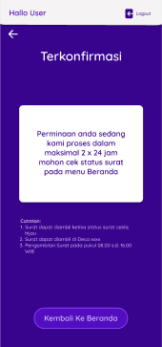
A-Diser
MOTIVATION
Improve Indonesia’s letter administration services
Optimization of the process fulfilling the requirements for making letters
Mobile application for letter administration services,
Get administrative letters faster,
no queuing with A-Diser
Notes:
Improve Indonesia's mail administration services with
Migrate to online services and integrate individuals information to improve certain regional mail administration services in Indonesia.

Slide 5


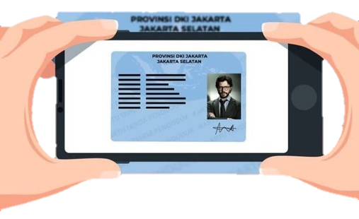

Features
Features
Take
Aways
App
FLow
Authentication
User will be identified with phone number
e-KTP Verification
Indonesian Identity Verification from Face and get data from e-KTP
Letter Admnistration Services
Indonesian Identity Verification with get data from e-KTP
Mobile Development

Slide 6


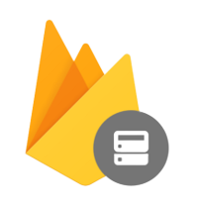
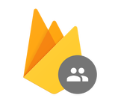
Our Take Away
Features
Android App
Take
Away
Firebase Authentication
App
Flow
Firebase Database Realtime
Firebase Storage
Mobile Development

Slide 7
App Flow
Features
Take
Away
App
Flow
Mobile Development

Slide 8

What We Do
What
We Do
Dataset
& Models
Optical Character Recognition
Extract image from KTP into text for automating fill registration form
Results
Machine Learning

Slide 9
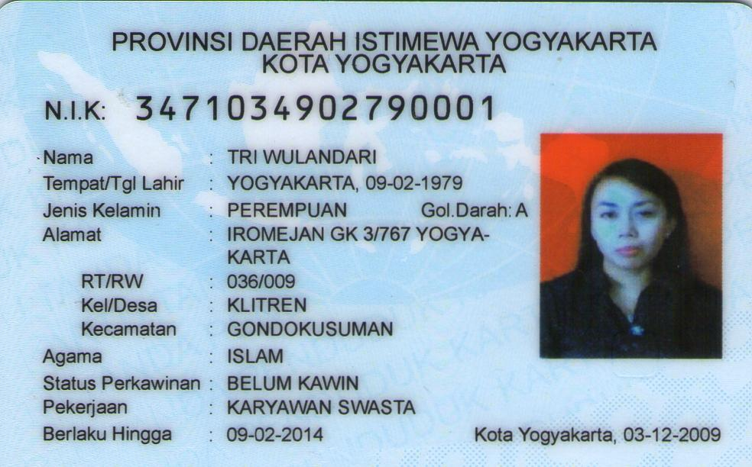
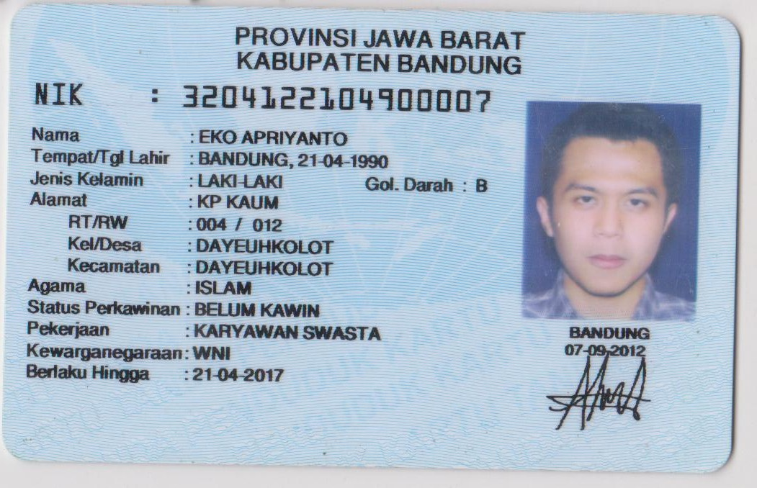
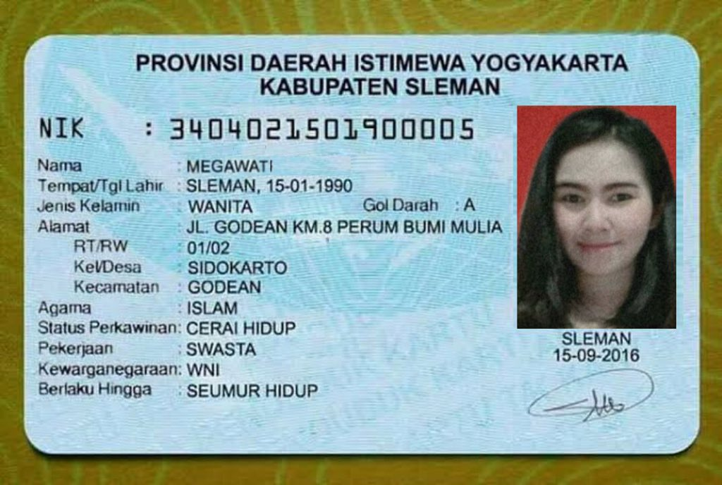

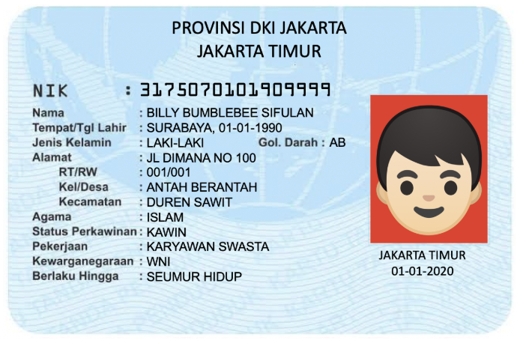

Dataset & Models
What
We Do
Datasets
5 Indonesian Identity Card (KTP)
Dataset
& Models
Models
Pytesseract
(tesseract)
Open CV – OCR
(Tecxt Recognition)
Results
Machine Learning

Slide 10
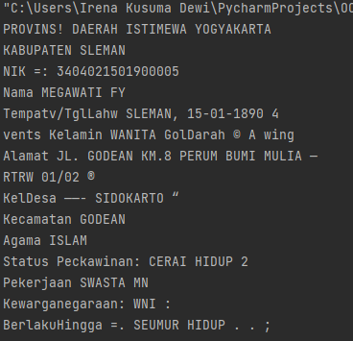
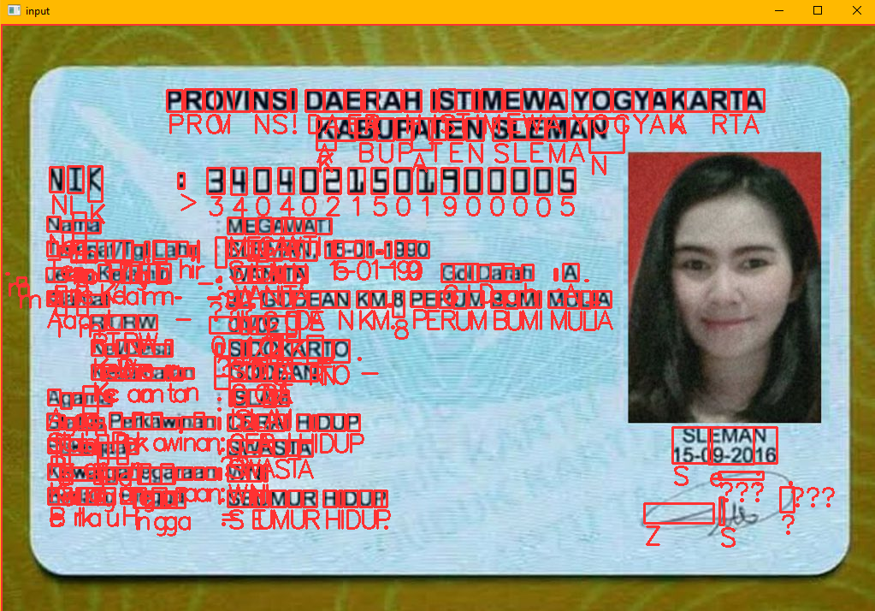
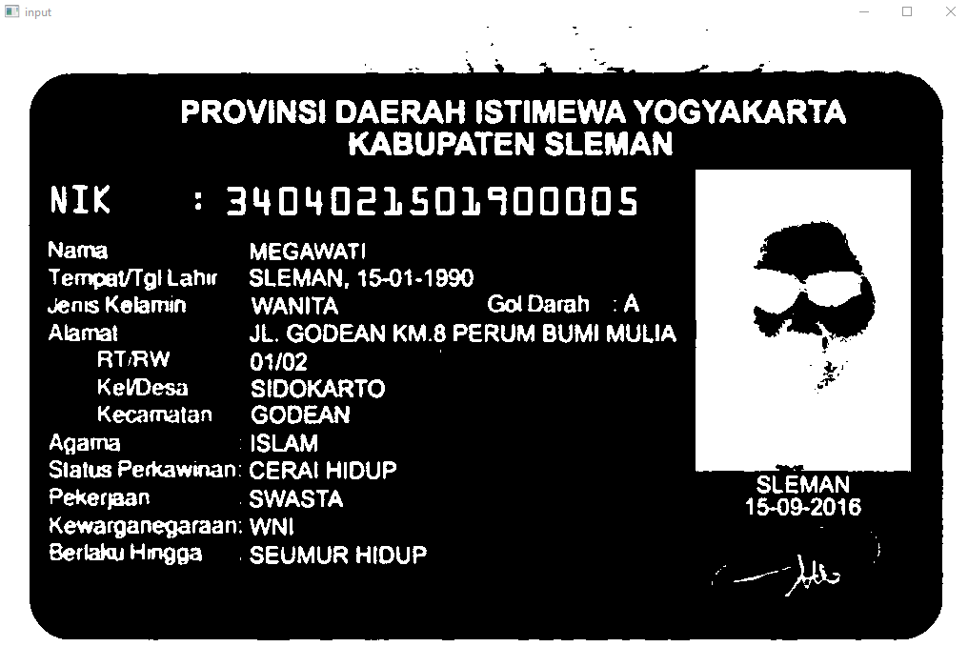
Results
What
We Do
Dataset
& Models
Results
OpenCV-OCR
Text Recognition
Tesseract
Detect character in image
Machine Learning

Slide 11




What We Do
What
We Do
Timeline
VM
Instance
Compute Engine VM Instance as the server of Machine Learning model
Cloud Function
Compute Engine VM Instance as the server of Machine Learning model
Cloud Firestore
Using Cloud Firestore and Cloud Storage function as the Database
Billing & Finance
Using Billing as a tool to check API usage bills
Cloud Computing

Slide 12
Timeline
What
We Do
1
Activating API and inputting data to the Database
2
Deployment and Integration process
2
Security And Monitoring
Timeline
Cloud Computing

Slide 13

Thankyou,

